Slide 1
Getting started with terraform and Azure Pipelines
Mark Gossa
Infrastructure Engineering Lead, Vanquis Bank

Slide 2
About me
Mark Gossa
@markgossa
https://markgossa.blogspot.com
Github.com/markgossa
Notes:
All things DevOps
Infrastructure as code
Mostly serverless

Slide 3
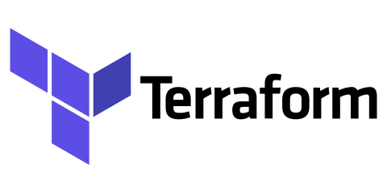
“Investing deeply in Terraform on Azure”
-Microsoft
Notes:
Why are Microsoft investing heavily in terraform - https://azure.microsoft.com/en-gb/blog/investing-deeply-in-terraform-on-azure/
Microsoft are maintaining the Terraform Azure plugin
What’s the point?
Why use it?
Why not use something else?

Slide 4
Overview
What is Terraform?
Why Terraform?
Other options?
How it works
Azure Pipelines
Notes:
Who’s heard of terraform?
Who’s tested terraform?
Who uses terraform in production?

Slide 5
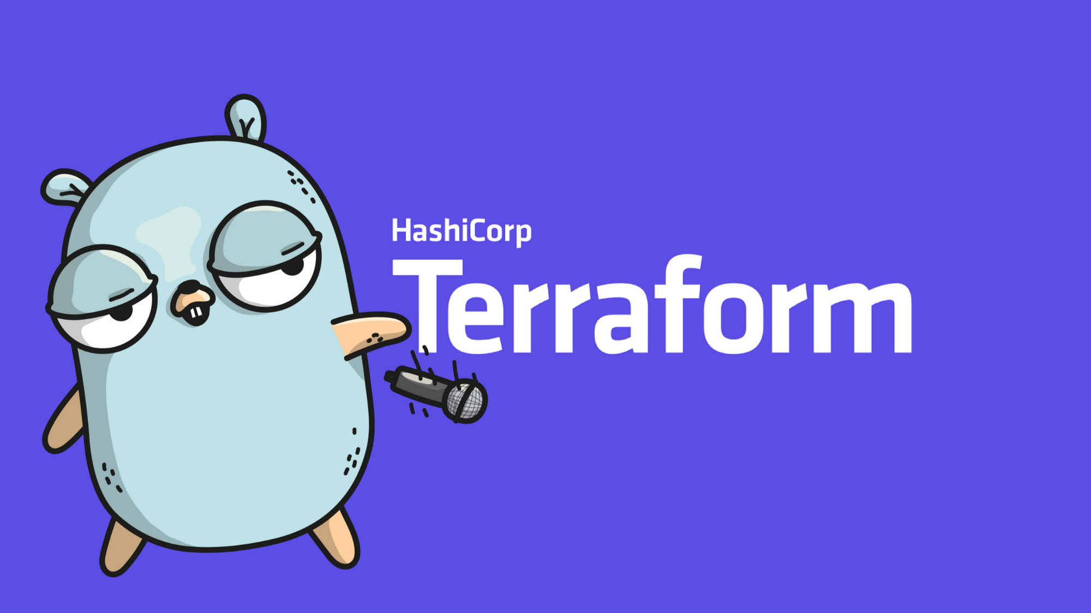
What is Terraform?
Infrastructure as Code
HCL
Multi-provider
Notes:
Infrastructure as Code – you basically write out code that defines what your infrastructure will look like
Cost reduction
Prevents snowflake servers/configuration drift
Idempotent
Speed/faster execution
Removes errors through manual misconfiguration
Repeatable
Self-documenting

Slide 6


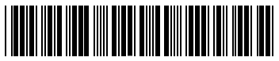
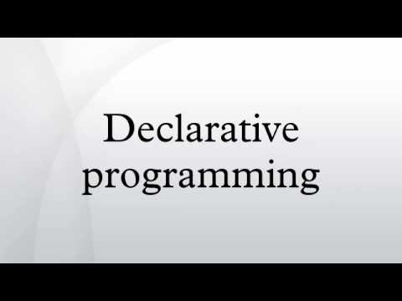




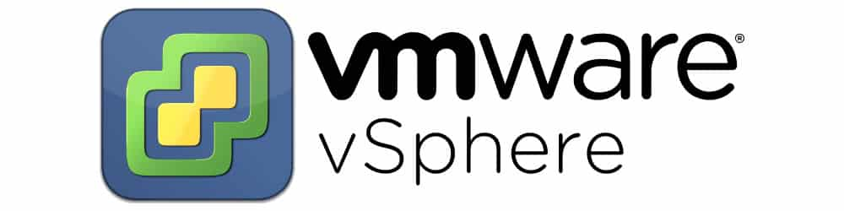
Why Terraform?
HCL
JSON
Notes:
Easy to read
No management server required, like Ansible, Chef, Puppet etc
Good online documentation. Open source/GitHub.
Terraform = declarative (like ARM templates, PowerShell DSC etc). PowerShell is imperative. Declarative = what the end should be like so just make it so. Imperative = all the steps to get from the current state to the end goal.
No installation needed for terraform
Multi-cloud: AWS, Azure, Google Cloud, VMware etc. Modules available for each vendor. Although you’re now learning another language (HCL), you can use it for all clouds.

Slide 7
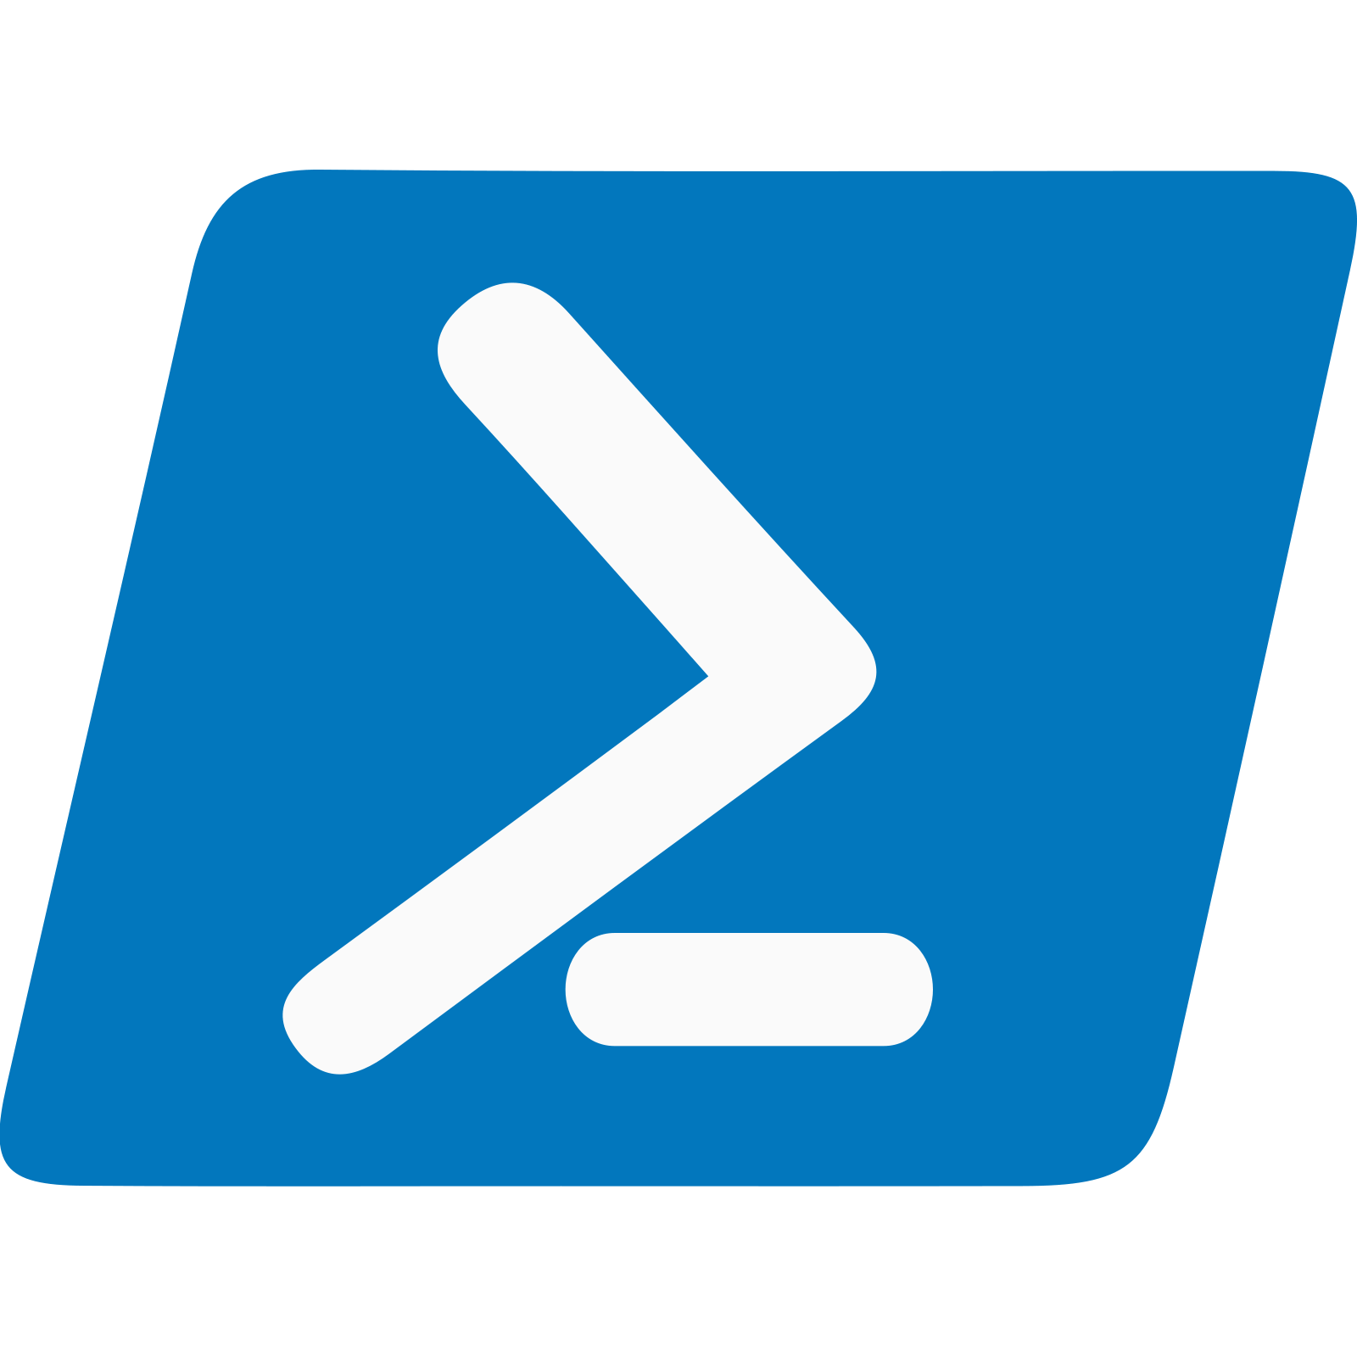
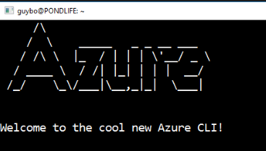

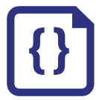
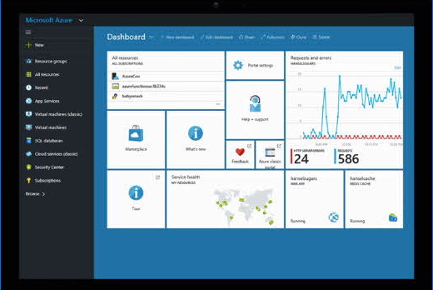
Other options
Azure REST API
ARM Templates
Notes:
There are many ways you can deploy Azure infrastructure
You want to move away from imperative tools and this includes PowerShell, REST API and .NET
I tried to make an Azure ‘DSC’ module
You want to move away from doing things manually so you get the benefits of infrastructure as code:
Faster deployment
Repeatibility
Source control/change tracking/auditability
Ability to deploy multiple identical environments
Self service
This leaves ARM templates as the main competitor

Slide 8
Terraform vs ARM templates
Property | Terraform | ARM Templates
Language | HCL | JSON
State file | Yes | No
Integration with Azure DevOps pipelines | Yes | Yes
Reusable modules | Yes | Yes
Multi-cloud | Yes | No
Plan output | Yes | No
Notes:
Language: Both have VSCode extension. With Terraform, you only need to learn HCL and you can use it with Azure, VMware, Google Cloud, AWS etc
ARM templates don’t keep a state file to improve deployment performance and keep track of metadata
Both have Azure DevOps integration and reusable modules. ARM templates use nested ARM templates.
ARM templates are just for Azure
Terraform can provide a plan of what it’ll do before it does it so you can check what it’s going to do

Slide 9
Terraform commands
Command | Description
terraform init | Downloads terraform plugins/modules
terraform plan | Displays a list of actions that terraform will perform
terraform apply | Applies changes to infrastructure
terraform destroy | Destroys infrastructure that was created

Slide 10
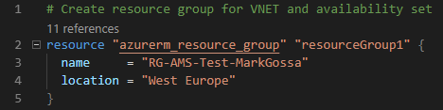
Terraform resources
Notes:
A resource is a component of your infrastructure e.g. resource group, virtual network, subnet, virtual machine
Resources have a TYPE and NAME
Resource configuration is inside {}
Multiple files

Slide 11
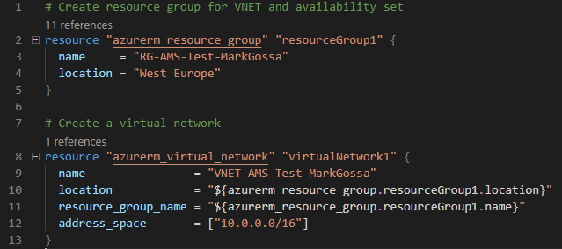
Terraform dependencies
Terraform creates all resources at the same time
Ensures that resources are created in order
Notes:
All resources created at the same time, if possible. It can create resources very quickly e.g. parallel VM deployments.
e.g. creates a network after the resource group is created

Slide 12
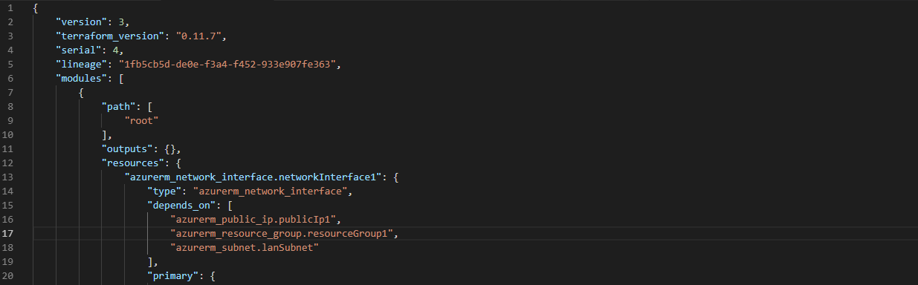
Terraform state file
Notes:
Tfstate – keeps a track of what’s been deployed to Azure
Terraform will destroy infrastructure if you remove it from your terraform configuration
Remote tfstate - you must have this to prevent others running the configuration at the same time
Don’t modify it
Don’t lose the terraform state file

Slide 13
Demo
Terraform

Slide 14

Azure Pipelines
What you need:
Azure subscription
Service Principal
Azure DevOps
Build agent (hosted or private)
Notes:
Service principal - You need to pass a service principal to Terraform so that it can authenticate with Azure (client_id, client_secret, subscription_id, tenant_id)
Azure DevOps – you can sign up for free
Build agent – hosted included in your Azure DevOps subscription (including free subscription)

Slide 15
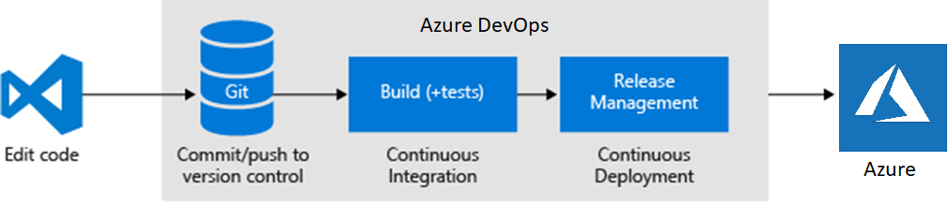
Azure Pipelines
Notes:
Edit code in VSCode, Visual Studio, notepad etc
Commit and push to source control. Doesn’t have to be Azure DevOps.
CI = build/compile the code and run unit tests
CD = deploy into environment and run integration tests

Slide 16
Azure Pipelines
Install Terraform
Terraform init
Terraform validate
Publish artifact
Notes:
Terraform validate = terraform checks the configuration is valid, including whether parameters are specified of the correct type etc
Other unit testing. You can look into other tools like kitchen-terraform and terratest.

Slide 17
Azure Pipelines
Install Terraform
Terraform init
Terraform validate
Install Terraform
Terraform init
Terraform plan
Terraform apply
Integration tests
Notes:
Integration tests can be anything. Can use PowerShell Pester or Chef InSpec etc.

Slide 18

Demo
Azure Pipelines

Slide 19



Who’s using terraform?
Notes:
We deploy our infrastructure using Terraform

Slide 20
Summary
What is terraform and why use it?
Terraform:
Configuration
Variables
Backend
Remote state
How to deploy terraform
Azure Cloud Shell
Azure Pipelines

Slide 21
“Why don’t you test it out?”

Slide 22

Thanks!
Mark Gossa
@markgossa
https://markgossa.blogspot.com
github.com/markgossa

